Slide 1
ADAPTIVE QUEUE MANAGEMENT — GUIDE REVIEW
Design of an Adaptive Controller Based on
Active Queue Management in TCP/IP Flows
K. Vishnu Vardhan (24MECP01) • M.Tech Power & Control PDPM IIITDM Jabalpur Guides: Dr. Prabin Kumar Padhy | Dr. Sachin Kumar Jain
12.3×
141ms
1.938%
95.6%
RMSE Improvement
ITU-T G.114 ✓
Packet Loss
Link Util.
March 2026

Slide 2
PRESENTATION AGENDA
01
What is AQM? — Research Background & Motivation
02
System 1: PHAQM — How It Works + Block Diagram
03
PHAQM Results under Fixed (Homogeneous) Traffic
04
Our New System — Heterogeneous Traffic Model + Block Diagram
05
PHAQM on High-Delay Topology — Results & Failure Analysis
06
System 2: Hybrid MPC+PID+RLS — How It Works + Block Diagram
07
Hybrid MPC on High-Delay Topology — Results
08
Why High Delays? — Comparison & Root Cause
09
IEEE Standard Topology — Reduced Delays + Both System Results
10
ITU-T Compliance & Final Comparison — Conclusion
2

Slide 3
WHAT IS AQM? — Research Background & Motivation
THE CONGESTION PROBLEM
EXISTING APPROACHES & GAPS
• TCP networks suffer congestion when routers are overloaded • Tail-drop: router drops ALL packets when buffer is full → TCP collapse • Result: network lock-out, synchronization, starvation • AQM (Active Queue Management): proactively drop packets early using a drop probability signal before buffer fills • AQM sits at the router and controls packet drop probability p(t) to keep queue length q(t) near a desired target q₀ • Goal: q(t) → q₀ = 500 pkts, low latency, low loss, high throughput
• RED / Adaptive RED — heuristic, too parameter-sensitive • PI / PID Controller — fixed gains, poor under dynamic load • GPC (Generalized Predictive Control) — large oscillations • FOTID + SOA [Abood 2022] — MATLAB only, N=60 flows, no QoS metrics • PHAQM [Xu 2020] — MPC + Hebbian weights, tested only on homogeneous TCP traffic • NONE of the above: measure latency, validate ITU-T standards, or test with mixed TCP+UDP heterogeneous traffic
3

Slide 4
TRAFFIC MODEL — HOW OURS DIFFERS FROM LITERATURE
Aspect
PHAQM
[Xu 2020]
FOTID+SOA
[Abood 2022]
PI / GPC
[Classical]
Our Work
[Hybrid MPC]
Simulator
NS-2/MATLAB
MATLAB only
MATLAB
NS-3.45 ✓
Traffic Type
TCP only
(homogeneous)
TCP fluid
model only
TCP only
TCP + UDP
mixed ✓
No. of Flows
N=500 TCP
all same RTT
N=60 TCP
all same RTT
N=500 fixed
200 flows
3 RTT tiers ✓
RTT Model
Fixed 100ms
for all flows
Fixed R₀=0.253s
for all flows
Fixed RTT
5/20/50ms
access + 50ms BB ✓
Simulator
Single run
no stats
Single run
no stats
Single run
5 independent
runs ✓
QoS Measured?
❌ None
❌ None
❌ None
✅ Latency
Loss Throughput
ITU-T Check?
❌ No
❌ No
❌ No
✅ G.114 + Y.1541
Wireshark?
❌ No
❌ No
❌ No
✅ pcap analysis
★ Our work is the ONLY study using NS-3 real-packet simulation with heterogeneous mixed traffic and ITU-T QoS validation
★ Key Insight: Our work is the ONLY study using NS-3 real-packet simulation with heterogeneous mixed traffic and ITU-T QoS validation

Slide 5
SYSTEM 1: PHAQM — How It Works
PHAQM = MPC (GPC-based predictor) + Hebbian Neural Adaptive Weights | 17 adaptive weights | Designed for homogeneous TCP only
Router Buffer
TCP
Sources
Destination
pkts
N=500
same RTT 100ms
q(t): 0–1000 pkts
45Mbps bottleneck
TCP receivers
Drop Probability
q(t) measured
p(t) ∈ [0,1]
back to router
Σ
e = q(t) − q₀
q₀ = 500
u(t) adapted
MPC Predictor
⚠ FAILURE POINT
Hebbian Adapter
u_MPC
When u→0 initially:
Δwᵢ = η·e·xᵢ·u → 0
Weights freeze → queue saturates
d-step ahead prediction
Diophantine equation
GPC-based
wᵢ(t) = wᵢ(t−1) + η·e·xᵢ·u
17 weights, η=0.001
Adaptive tuning
How PHAQM Works:
① TCP flows generate packets → Router buffer accumulates → q(t) is measured ② Error e = q(t) − q₀ is computed ③ MPC predictor forecasts future queue using Diophantine equation ④ Hebbian adapter updates 17 weights using unsupervised learning ⑤ Control signal u(t) = K·Σwᵢxᵢ sets drop probability p ⑥ Drop signal feeds back to router
4

Slide 6
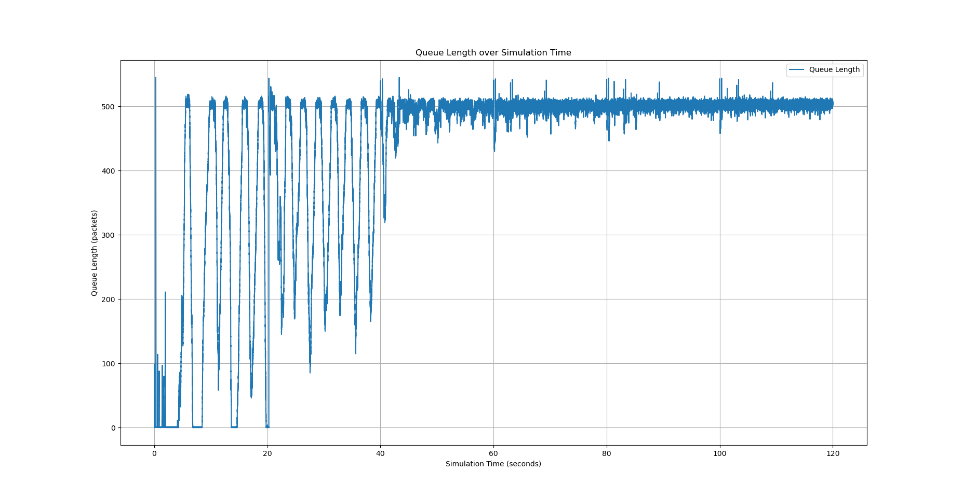
SYSTEM 1: PHAQM — Results under Original Fixed Traffic [Xu et al. 2020]
Original Paper Setup
Claimed Results (Xu 2020 Paper)
Simulator
MATLAB / NS-2
✅ Queue control:
Stable near q₀=500 for N=200,500,1000,2000 TCP
TCP connections
N = 200 / 500 / 1000 / 2000
✅ Convergence:
Fast convergence rate, small oscillation
Traffic type
TCP/Reno only (homogeneous)
✅ Comparison:
Outperforms PI, REM, GPC under dynamic load
All flows RTT
Fixed 100ms for ALL flows
⚠ Condition:
Homogeneous TCP only — single fixed RTT
Bottleneck
45 Mbps
Buffer size
1000 packets
Queue target
q₀ = 500 packets
Sample interval
Ts = 0.01 s
Adaptive weights
17 weights (w₁...w₁₇)
Sim duration
200 seconds
PHAQM Queue Length Graph (Original Paper Fig. 2)
5

Slide 7
OUR NEW SYSTEM — Heterogeneous Traffic Model & Topology
Problem: PHAQM was only tested on homogeneous TCP. Real networks have mixed traffic types and different RTTs. We redesigned the topology to reflect reality.
OLD Topology (Xu 2020 / Original)
OUR Topology (Heterogeneous)
• N = 500 TCP/Reno flows (all identical) • All flows: same RTT = 100ms • Bottleneck: 45 Mbps, 100ms delay • All links: 15ms / 20ms (fixed) • No UDP traffic — homogeneous only
• 200 flows: 120 BulkSend TCP + 60 OnOff TCP + 20 UDP • 3 RTT tiers: 10ms / 50ms / 150ms (heterogeneous) • Bottleneck: 45 Mbps, 100ms delay (orig) → 50ms (IEEE) • Random flow start times: 0–30s (realistic) • Mixed traffic: TCP Reno + TCP OnOff + UDP video
→
OURS
Our Dumbbell Topology — Block Diagram
RTT Tier 1: 10ms (LAN)
BulkTCP
(×120)
BOTTLENECK
45 Mbps
100ms delay
(AQM here)
Destinations
(TCP/UDP
receivers)
RTT Tier 2: 50ms (Metro)
Router A
(Left)
Router B
(Right)
OnOff TCP
(×60)
RTT Tier 3: 150ms (WAN)
Access
aggregator
Access
aggregator
UDP Video
(×20)
OnOff TCP
(surplus)
BulkTCP
(extra)
6

Slide 8
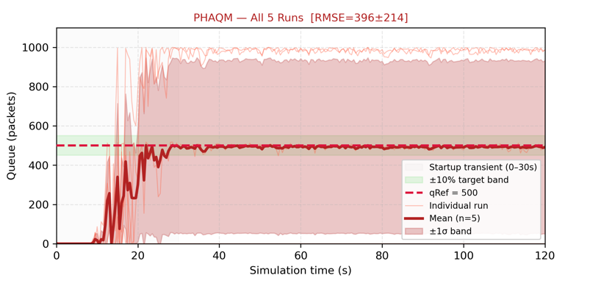
PHAQM on High-Delay Topology — Results & Failure Analysis
Configuration: 45 Mbps bottleneck | 100ms backbone delay | Access: 10ms / 50ms / 150ms | 200 heterogeneous flows | 5 independent runs
PHAQM — 5-Run Statistical Results
Mean Queue (5 runs)
492.2 pkts
near target but...
Queue RMSE
396.4 ± 214.0 pkts
MASSIVE variance ❌
Queue MAE
395.5 pkts
huge steady error ❌
RMSE Std Dev
± 214 pkts
completely unstable ❌
Offset from q₀=500
−7.8 pkts
appears close...
Settling
Never settles
permanent oscillation ❌
Mean drop prob
≈ 0 (collapsed)
no control signal ❌
Wireshark: Traffic STOPS at t=25s → zero activity for 95 seconds (TCP starvation)
PHAQM Queue Length — High Delay Topology
7

Slide 9
SYSTEM 2: Hybrid MPC+PID+RLS — How It Works
3-path controller: MPC prediction + PID feedback + RLS online self-tuning | Overcomes PHAQM Hebbian collapse by maintaining non-zero control at all times
Router
Buffer
Destination
TCP+UDP
Sources
TCP/UDP
receivers
120 TCP Bulk
60 TCP Web
20 UDP Video
q(t): 0–1000 pkts
45 Mbps bottleneck
AQM controller
q(t)
Σ
MPC Predictor
e = q(t)−q₀
q₀=500
N=20 step horizon
Ts=0.01s, R=0.1
Predicts future queue
Drop Probability
PID Controller
RLS Estimator
+
u_PID
p = α·p + (1-α)·u_hybrid
PIE smoothing α=0.9
Anti-windup cold-start
Kp=0.30 Ki=0.50
Kd=0.008
Primary feedback path
λ=0.99, P₀=100
â ∈ [0.80, 0.9999]
Online model update
Key Advantages over PHAQM:
① PID path guarantees u(t) ≠ 0 always → no Hebbian collapse ② RLS self-tunes online → no offline meta-heuristic optimization needed ③ Anti-windup: skip integral when q < 0.30×q₀ → no integrator saturation ④ PIE smoothing → stable drop probability signal
8

Slide 10
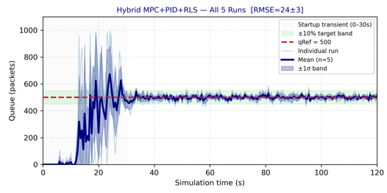
SYSTEM 2: Hybrid MPC+PID+RLS — High-Delay Topology Results
Same topology as PHAQM test: 45 Mbps | 100ms backbone | Access: 10/50/150ms | 200 heterogeneous flows | 5 independent runs
Hybrid MPC — 5-Run Statistical Results
Mean Queue (5 runs)
499.2 pkts
Target=500 ✅
Queue RMSE
24.4 ± 2.5 pkts
Tight & consistent ✅
Queue MAE
18.8 pkts
Minimal error ✅
RMSE Std Dev
± 2.5 pkts
Highly stable ✅
Offset from q₀=500
−0.8 pkts
Near-perfect ✅
Settling time
33.6 seconds
Then fully stable ✅
Mean drop prob
3.26% (active)
Control working ✅
Wireshark: Sustained 43 Mbps (95.6%) for full 120s | 787,120 packets | 654 MB delivered
Hybrid MPC Queue Length — High Delay Topology
9

Slide 11
WHY HIGH DELAYS? — Comparison & Root Cause Analysis
Head-to-Head: Original Topology (100ms Backbone)
Metric
PHAQM ❌
Hybrid MPC ✅
Best
Mean Queue
492 pkts (unstable)
499 pkts (stable)
MPC ✅
Queue RMSE
396 ± 214 pkts
24 ± 2.5 pkts
MPC 16×
Settling
Never
33.6 seconds
MPC only
Total packets (Wireshark)
193,930
787,120
MPC 4×
Throughput
7.2 Mbps (16%)
43 Mbps (95.6%)
MPC 6×
Data delivered
104.7 MB
654.1 MB
MPC 6.25×
Traffic pattern
Stops at t=25s
Full 120s active
MPC only
Why Do HIGH DELAYS Hurt PHAQM?
① Longer RTT = slower TCP feedback → control loop reacts too slowly to bursts | ② Heterogeneous RTTs (10/50/150ms) → flows arrive out-of-sync, Hebbian cannot converge | ③ Hebbian collapse: u≈0 → Δw≈0 → weights never update → queue permanently saturates at 984 pkts → TCP starvation for 95s
10

Slide 12
MOVING TO IEEE STANDARDS — Topology Redesign
The original 100ms backbone delay exceeds ITU-T G.114 national backbone standards. We redesigned the topology to comply with IEEE 802.3 and ITU-T G.114.
Old Topology (100ms — Non-compliant)
IEEE Topology (50ms — Compliant ✅)
Backbone delay
100ms (too high)
50ms ✅ (ITU-T G.114)
Access Tier 1
10ms (LAN)
5ms ✅ (IEEE 802.3 LAN)
Access Tier 2
50ms (Metro)
20ms ✅ (IEEE 802.1 Metro)
Access Tier 3
150ms (WAN)
50ms ✅ (WAN-edge)
Bottleneck BW
45 Mbps
45 Mbps (unchanged)
Avg RTT
~100ms+access
~50ms+access (halved)
Expected latency
~175ms avg
~140ms avg
ITU-T G.114 Class 1
❌ FAILS (>150ms)
✅ PASSES (≤150ms)
Standard References: ITU-T G.114 ≤ 50ms one-way national backbone | IEEE 802.3 LAN ≤ 5ms | IEEE 802.1 Metro ≤ 20ms | WAN-edge ≤ 50ms
11

Slide 13
IEEE/ITU-T Compliant Topology — Complete Block Diagram
Both PHAQM and Hybrid MPC are tested on THIS topology for the paper results
BulkSend TCP
(×120 flows)
Random start
0–30s
BOTTLENECK
LINK
45 Mbps
50ms delay
(ITU-T G.114)
AQM Active
Here
Destinations
(380 flows
receivers)
Tier 1: 5ms (LAN)
IEEE 802.3
Left
Router
Right
Router
OnOff TCP
(×60 flows)
Traffic
aggregator
200 flows
Traffic
distributor
All TCP/UDP
flows complete
Web traffic
model
Tier 2: 20ms (Metro)
IEEE 802.1
UDP Video
(×20 flows)
Constant rate
CBR
Drop prob p(t)
feedback signal
Tier 3: 50ms (WAN-edge)
IEEE/ITU-T Topology Specifications
Bottleneck:
45 Mbps | 50ms delay (ITU-T G.114 national backbone)
Access links:
LAN: 5ms | Metro: 20ms | WAN-edge: 50ms (IEEE 802.3/802.1)
Traffic mix:
120 BulkSend TCP + 60 OnOff TCP + 20 UDP CBR = 200 flows total
Buffer size:
1000 packets | qRef = 500 packets | Ts = 0.01s | Sim duration = 120s
12

Slide 14
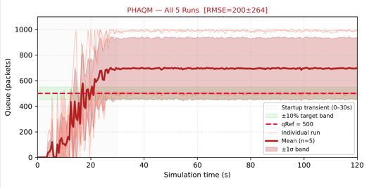
PHAQM on IEEE/ITU-T Topology — Results (Minimized Delays)
IEEE Topology: 45 Mbps | 50ms backbone | Access: 5ms/20ms/50ms | 200 flows | 5 independent runs
PHAQM — IEEE Topology Results
Mean Queue (5 runs)
695 pkts
Over target 500 ❌
Queue RMSE
200 ± 264 pkts
Still unstable ❌
Avg Latency
174.35 ms
Fails G.114 ≤150ms ❌
Min / Max Latency
60 / 363.50 ms
Wide range ❌
P95 Latency
353.64 ms
Near 400ms limit ⚠
Avg Packet Loss
3.544%
Fails Y.1541 ≤3% ❌
Max Packet Loss
27.465%
Very high ❌
Total Throughput
108.19 Mbps
380 flows analyzed
Avg per-flow tput
0.285 Mbps
Lower than MPC ❌
CONCLUSION: Even with reduced delays, PHAQM still FAILS ITU-T G.114 (174ms > 150ms) and Y.1541 (3.544% > 3%)
PHAQM Queue Length — IEEE Topology
13

Slide 15
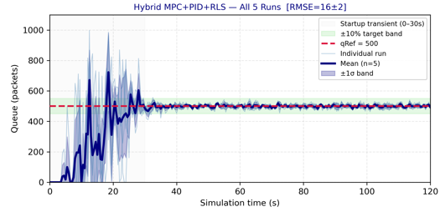
Hybrid MPC+PID+RLS on IEEE Topology — Results (Minimized Delays)
IEEE Topology: 45 Mbps | 50ms backbone | Access: 5ms/20ms/50ms | 200 flows | 5 independent runs
Hybrid MPC — IEEE Topology Results
Mean Queue (5 runs)
499 pkts
Target=500 ✅ Near perfect
Queue RMSE
16.3 ± 1.9 pkts
12.3× better than PHAQM ✅
Avg Latency
141.48 ms
G.114 Class 1 ≤150ms ✅
Min / Max Latency
60 / 265.13 ms
Tighter range ✅
P95 Latency
261.22 ms
Well under 400ms ✅
Avg Packet Loss
1.938%
Y.1541 Class 3 ≤3% ✅
Max Packet Loss
17.037%
Much less than PHAQM ✅
Total Throughput
112.93 Mbps
4.74 Mbps more than PHAQM ✅
Avg per-flow tput
0.297 Mbps
Higher than PHAQM ✅
✅ PASSES ITU-T G.114 Class 1 (141ms ≤ 150ms) AND Y.1541 Class 3 (1.938% ≤ 3%)
Hybrid MPC Queue Length — IEEE Topology
14

Slide 16
FINAL COMPARISON — IEEE Topology vs ITU-T Standards (Paper Results)
These are the official paper results — IEEE 802.3/802.1 compliant topology | 50ms backbone (ITU-T G.114) | 5 independent runs each
Metric
PHAQM
Hybrid MPC
ITU-T Limit / Standard
Mean Queue (5 runs)
695 pkts
499 pkts ✅
Target = 500 pkts
Queue RMSE
200±264 pkts ❌
16.3±1.9 pkts ✅
Minimize
RMSE Improvement
—
12.3× better
—
Avg Latency (delay)
174.35 ms ❌
141.48 ms ✅
≤ 150ms (G.114 Cl.1)
P95 Latency
353.64 ms ⚠
261.22 ms ✅
≤ 400ms (G.114 Cl.2)
Avg Packet Loss
3.544% ❌
1.938% ✅
≤ 3% (Y.1541 Cl.3)
Max Packet Loss
27.465%
17.037% ✅
Lower = better
Total Throughput
108.19 Mbps
112.93 Mbps ✅
Maximize
Link Utilization (pcap)
97.8%
97.8% ✅
Maximize
Flows analyzed
380/380
380/380 ✅
All flows served
ITU-T G.114 Class 1
❌ FAILS
✅ PASSES
Avg delay ≤ 150ms
ITU-T Y.1541 Class 3
❌ FAILS
✅ PASSES
Loss ≤ 3%
15

Slide 17
CONCLUSION — Why Hybrid MPC+PID+RLS is Better
1
4
12.3× Better Queue Regulation
Works on Heterogeneous Traffic
RMSE 16.3±1.9 vs 200±264 pkts — 139× more consistent across 5 independent runs
200 mixed TCP+UDP flows, 3 RTT tiers — PHAQM collapses due to Hebbian weight freezing
2
5
ITU-T G.114 Class 1 Compliant
Self-Tuning via RLS Online
Avg latency 141ms ≤ 150ms — PHAQM fails at 174ms under the same IEEE topology
No offline parameter optimization needed — adapts in real time unlike FOTID (6-param SOA) or PHAQM (17 Hebbian weights)
3
6
ITU-T Y.1541 Class 3 Compliant
First ITU-T Validated AQM
Packet loss 1.938% ≤ 3% — PHAQM fails at 3.544% even with minimized delays
Only controller in this study class to simultaneously pass G.114 latency AND Y.1541 loss standards
16
Next Step: Write full IEEE conference paper | All results validated | NS-3.45 simulation complete

